Slide 1
Mercadolibre.com
(Network Economics in Electronic Auction)

Slide 2
Who is Mercadolibre.com?
Mercadolibre
Latin America No.1 Online Auction Site
E-bay’s Latin America partner
(Argentina, Brazil, Chile, Colombia, Mexico, Ecuador, Peru,
Uruguay, Venezuela, Panama, Costa Rica, Dominic Republic)
History
1997-1999, Marcos Galperin developed business plan at Stanford MBA
1999 August, established in Argentina by Marcos Galperin(current CEO)
1999 September, expanded into most South America
2001 October, Mercadolibre signed an agreement with eBay
2005 November, Mercadolibre acquired 8 DeRemate’s operations
(all operations except Argentina and Chile)
2006, new operations in Costa Rica, Panama and Dominic Republic

Slide 3
Competition : DeRemate.com
Deremate.com
Alec Oxenford developed business plan at HBS MBA
1999 August, launched at the same time Mercadolibre(Network Effect)
Deremate licensed its core auction tech from a European company
(Quick launch, but rigid system change)
Aggressive communication campaign
(Quickly achieved customer awareness)
2001 October, lost the eBay deal
Mercadolibre signed an agreement with eBay
2005 November, Mercadolibre acquired 8 DeRemate’s operations
2 operations were acquired by local media groups
Dereto.com, servicing Argentina, Chile, Colombia and Mexico

Slide 4
Free Listing Day & D-day
Free Listing Day
■ Free Listing for registered products for the first time during one day
■ Introduction to activate Inactive User and Listing of new product
■ Specific date is secret, Notice 2 days before
■ Let major customer know a week in advance individually
■ Marginally benefit by standard before merging Deremate
D-day
■ Offer Optional Feature service at half price for one day
■ Effective promotion method and no negative influence on profit
In Monopolistic Position by merging ‘Deremate’
Is Maintaining Free Listing Day Necessary?

Slide 5
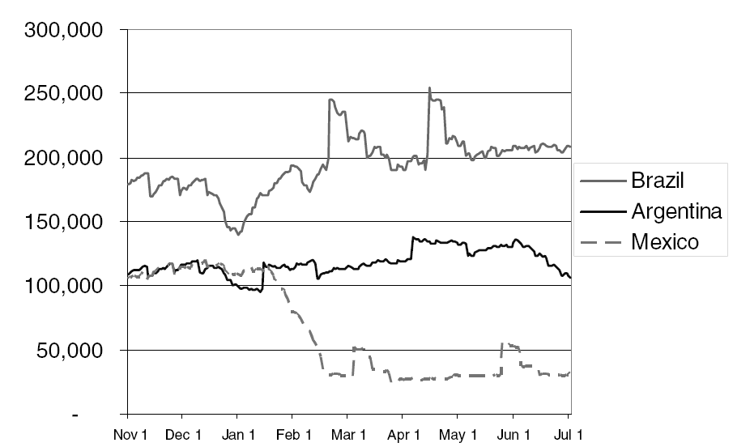
Effect of Free Listing Day
Number Of Live Listings
■ High growth rate, more than 20%, on Free Listing Day
■ Gradually decrease and stay at the level as before
■ Very high real transaction rate
Because effect of Free Listing Day shows sudden rise and fall in a
short term, it makes negative influence on profit structure instead

Slide 6
Conclusion
E-commerce: Advertising revenues are not sufficient for profit
Yardstick: Increased number of visitors after promotion event (Free listing day)
  Some countries, some cases (Argentina- Competition)
Economics of Pricing Policy
  Optional Features Fee vs. Listing Fee
  Network Externalities
  Learning from History: Don’t charge on the network itself (NYSE) –> Make profit from value added
  Example in Korea (Competitors): Kinked demand (Freechal vs. Cyworld)

Slide 7
Network Economics
Network Externalities
  Definition: Phenomena when value is influenced by number of users
  Example: telephone, Fax
  Strategy: Reasons why even inferior products win in the market (Ex: Windows OS, Video Standard(VHS, vs. Beta))
Network Externality analysis on UCC

Slide 8
Versioning Information
Byung Joon Yoo

Slide 9
Value-Based Pricing
Don’t need to price by identity (Personalized pricing) – Majority can be captured by versioning
Offer product line, and watch choices
Design menu of different versions (2nd Degree Price Discrimination)
  Target different market segments
  Price accordingly (self selection)

Slide 10
Quicken Example Revisited
Quicken for Windows at $20
Quicken Deluxe (w. Extra features, Self-selection) at $60

Slide 11
Traditional Information Goods
Hardback/paperback
Movie/video (Delay in time dimension)

Slide 12
Dimensions to Use
Delay (Fed Ex, PAWWS-Stock quotes)
User Interface (DialogWeb, DataStar-Also related with lock-in)
Image Resolution (PhotoDisk)
Speed of operation (Mathematica-Library)
Capability (Kurzweil-Voca for specialists)
Features (Quicken, Netscape-tech support)

Slide 13
Example
40 type As: $100 for speed, $40 for slow
60 type Bs: $50 for speed, $30 for slow
Identity-based pricing: $7000 revenues
Offer only speedy: $50 is best price, revenues=$5,000 (High end if versioning is not available)
Offer only slow: not as profitable

Slide 14
Versioning Solution
Try speedy for $100, slow for $30
  Will this work? Compare benefits and costs
  100-100=0, but 40-30=10 > 0
  Discount the fast version: 100-p=40-30 (Incentive Compatibility)
  So, p=90
  Revenues = $5,400 = 90x40 + 30x60

Slide 15
Making Self-Selection Work
May need to cut price of high end
May need to cut quality at low end
Value-subtracted versions
  May cost more to produce the low-quality version. (to delimit)
In design, make sure you can turn features off later!

Slide 16
Pitfalls
Arbitrage
  Windows NT workstation/server (Simple correction)

Slide 17
Online and Offline
Versions
The Whole Internet
Netscape Navigator – Better quality of offline products
National Academy of Science Press
  Format for browsing, not printing (Manipulation of information)

Slide 18
How Many Versions?
One is too few
Ten is (probably) too many
Two things to do
  Analyze market
  Analyze product

Slide 19
Analyze Your Market
Does it naturally subdivide into different categories? (Segments) AND
Are their behaviors sufficiently different?
Example: Airlines
  Tourists vs. Business travelers

Slide 20
Analyze Your Product
Dimensions to version
High and low end for each dimension
Top-Down approach recommended. Why?
  Design for high end, reduce quality for low end (for competition)
  Low end advertises for high end

Slide 21
Goldilocks Pricing
Mass market software (word, spreadsheets)
  Network effects
  User confusion
Default choice: 3 versions
Extremeness aversion
Small/large vs. small/large/jumbo (Focal point)
(*My research explains why this happens in a different way wrt. costs related to this)

Slide 22
Microwave Oven Example
Bargain basement at $109, midrange at $179
  Midrange chosen 45% of time
High-end at $199 added
  Mid-range chosen 60% of time
Wines
  Second-lowest price

Slide 23
Customizing the Browser
Collect behavior information (Java)
Optimize viewing for different customers
Can turn features on and off

Slide 24
Bundling
Offer a package
Microsoft Office
  90% market share
Work together
Discount one of the products
Option value: zero incremental price after purchase (sunk cost)
  Example: Microsoft’s per-process license for PC factories

Slide 25
Reduce Dispersion
Example: price separate or together
Mark: $120 for WP, $100 for spreadsheet
Noah: $100 for WP, $120 for spreadsheet
Profits
  Without bundling: $400
  With bundling: $440

Slide 26
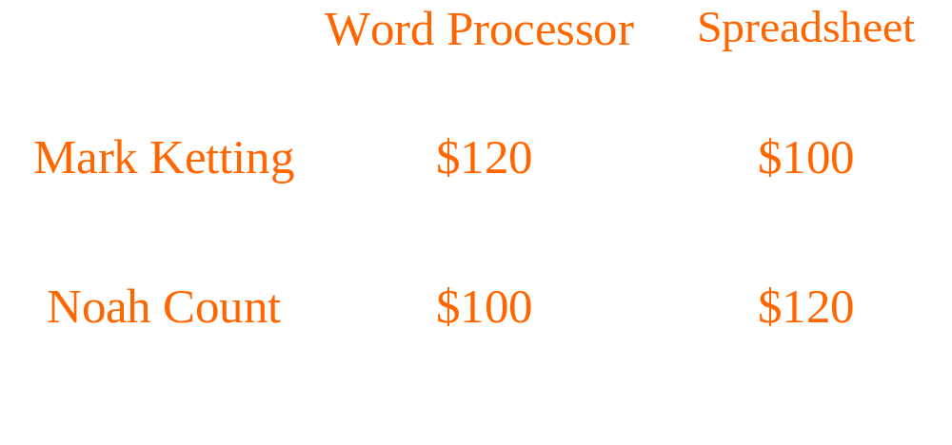
Reduce Dispersion:
Price separate or together?
Profits: With Bundling: $440 Without: $400

Slide 27
Information Bundles
Magazines and newspapers, cable TV channels
Law of large numbers (Central limit theorem)
Customized bundles
Nonlinear pricing (= Quantity discount)
  In previous example sell first item for $120
  Sell second item for $100
  Example: Music sites

Slide 28
Promotional Pricing
Sales, coupons, rebates (enforce inconvenience costs)
Only worthwhile if market is segmented
and Credible signal of price sensitivity
Problem with software agents (become less powerful – Frictionless market)
  Bargain Finder
  Price Scan (Korea, Danawa etc.)

Slide 29
Lessons
Version your product
Delay, interface, resolution, speed, etc.
Add value to online information
Numbers of Versions: Use natural segments
Otherwise use 3
Control the browser
Bundling may reduce dispersion

Slide 30
Next Session
Ch 4. Right Management
EC: EC Marketing (Ch. 6)

